Slide 1
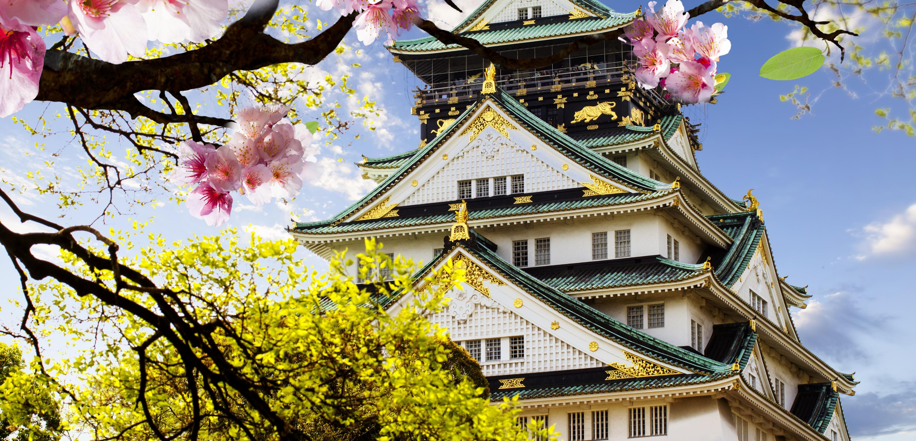
MGNT 102 Assignment 2
Members : Sheng Fatt, Eugene, Sulabh, Allen, Yu Xian

Slide 2
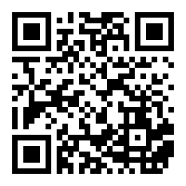
Download materials
Get this pptx and the skit by scanning the QR Code or by visiting the following link: https://bit.ly/grp3mgnt

Slide 3
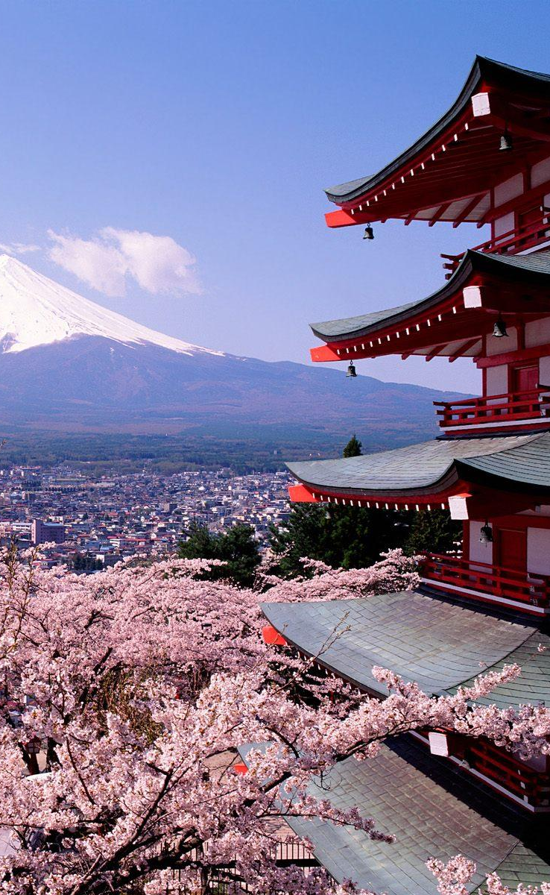
Quick intro on japan
Japan’s population: 126, 476, 461
Japan’s Total Fertility Rate (TFR) is 1.4 live births per woman, and 2.1 is the average number of live births required for each generation to exactly replace itself without immigration. Which means japan is facing an ageing population
Working class male to female ratio (age 29-65): 101.99 males to 100 females
Japan is one of the largest and most developed country in the world, and also a world leader in the manufacturing of electrical appliances.
(Japan Demographics 2020 (Population, Age, Sex, Trends) - Worldometer, 2021)
(Japan Male to female ratio, 1950-2020 - knoema.com , 2021)

Slide 4

Japan general mannerisms
Shaking hands and bowing
Greet the person by using his/her last name and add a prefix based on seniority
Never eat directly from a common plate
Pour drinks for others
Pay your client’s check
Do not point in Japan
Avoid direct confrontation or speech
The Japanese do not enjoy physical touch like hugs and pats on the back.
(Spacey, 2021)

Slide 5

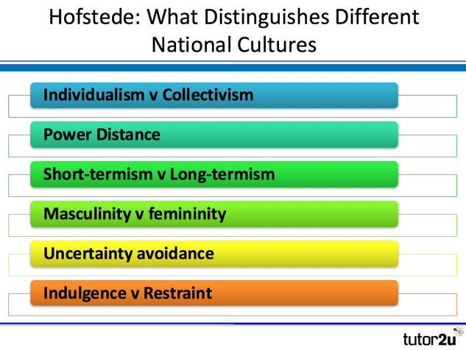
Hofstede’s model
(Riley, 2021)

Slide 6
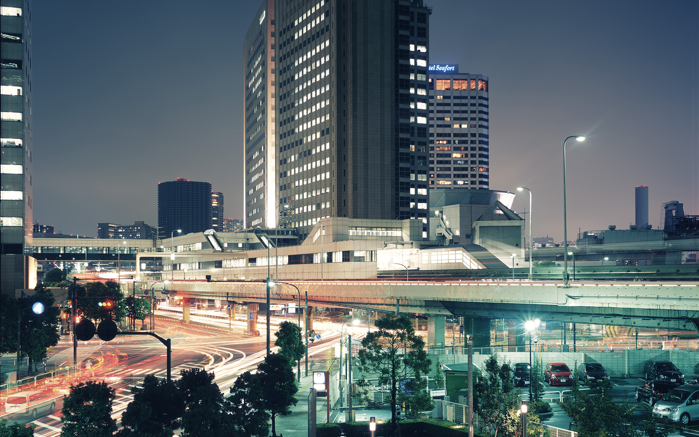
Power Distance
Score of 54 vs Singapore score 74
Mid to high range
Japanese are conscious of hierarchical positions and act accordingly.
Follow more of a chain of command then one top guy making all decisions
Meritocrat system in Japan
Strong notion in educational system stating that everyone is born equal, with the same rights to work hard
(Country Comparison - Hofstede Insights, 2021)

Slide 7
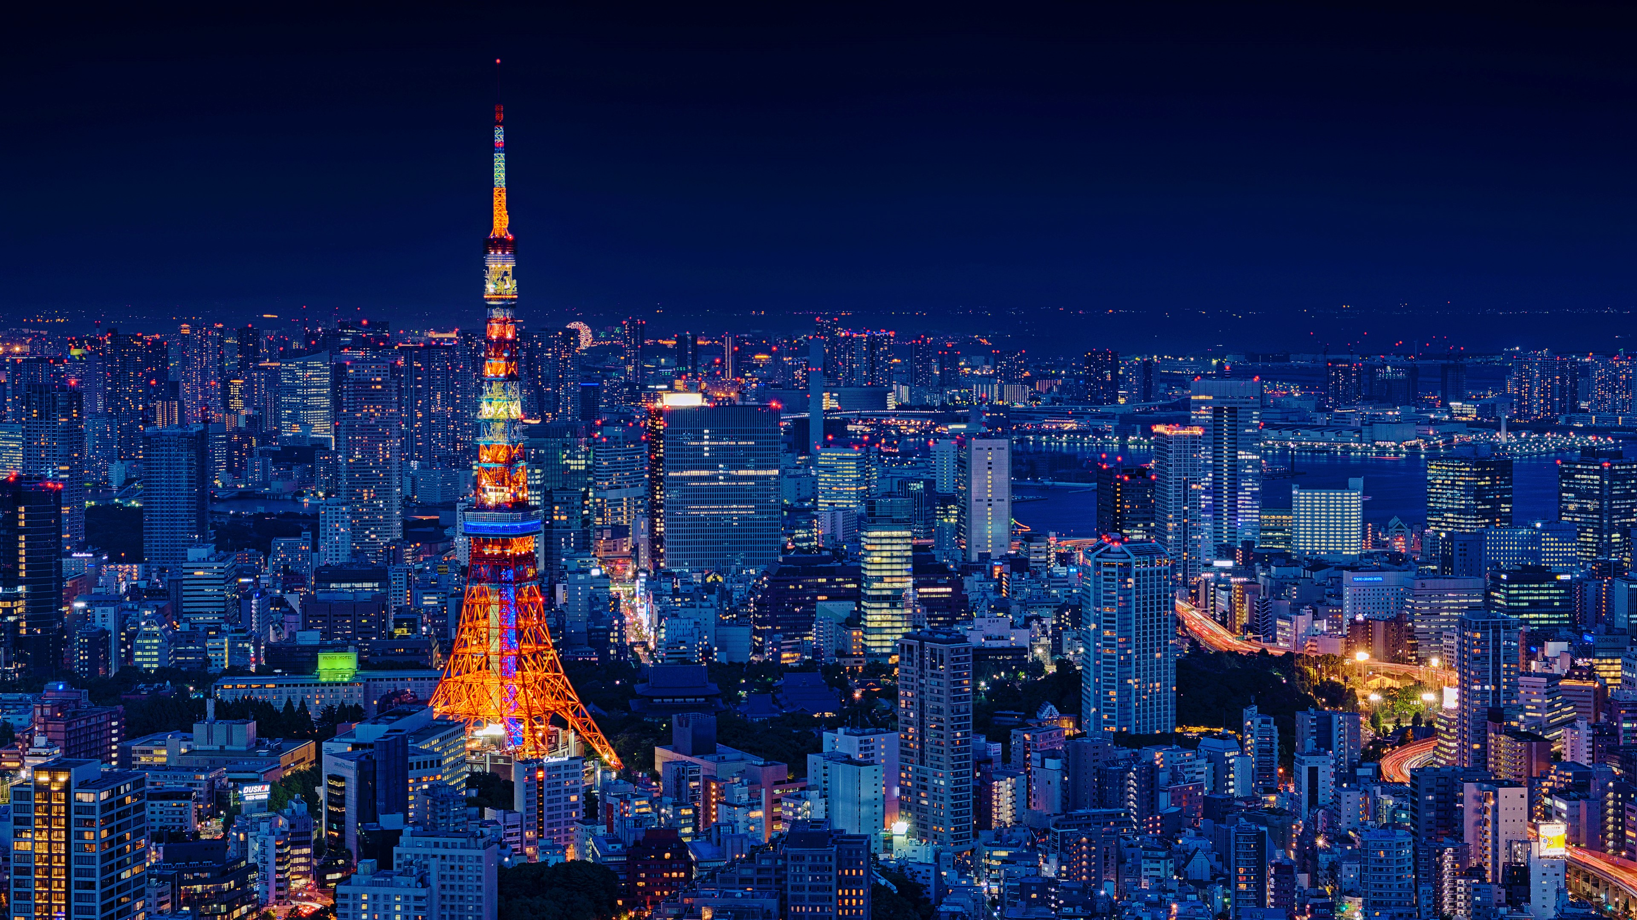
Individualism vs collectivism
“I” or “We”
Score 46 vs Singapore 20
Japan sides individualism
There are characteristics of collectivism, like not letting other’s lose face and putting group harmony above individual opinions
Paternalistic society
Japanese can be loyal to their companies, but that is what they chose to do
(Country Comparison - Hofstede Insights, 2021)

Slide 8
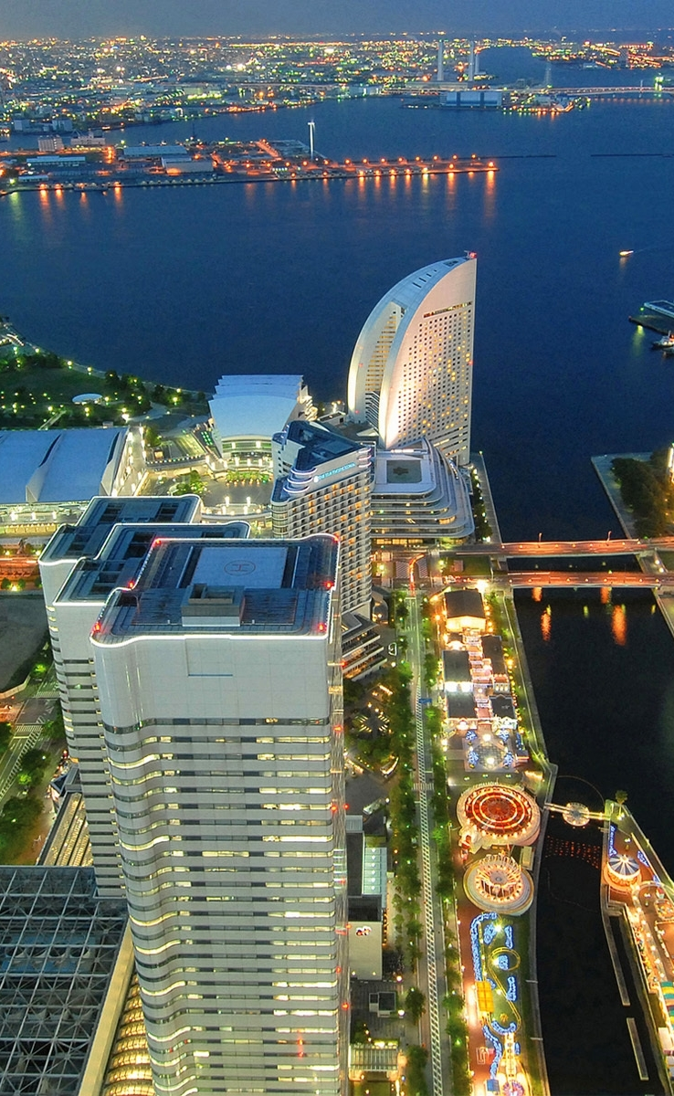
Masculinity vs femininity
Masculine: Driven by competition, achievements and success
Feminine: Caring for others and quality of life
Score 95 vs Singapore 48
Japan is one of the most masculine countries in the world
However, they don’t display assertive and competitive individuals as you would in a general masculine society
Masculinity in Japan refers to its drive for excellence
(Country Comparison - Hofstede Insights, 2021)

Slide 9
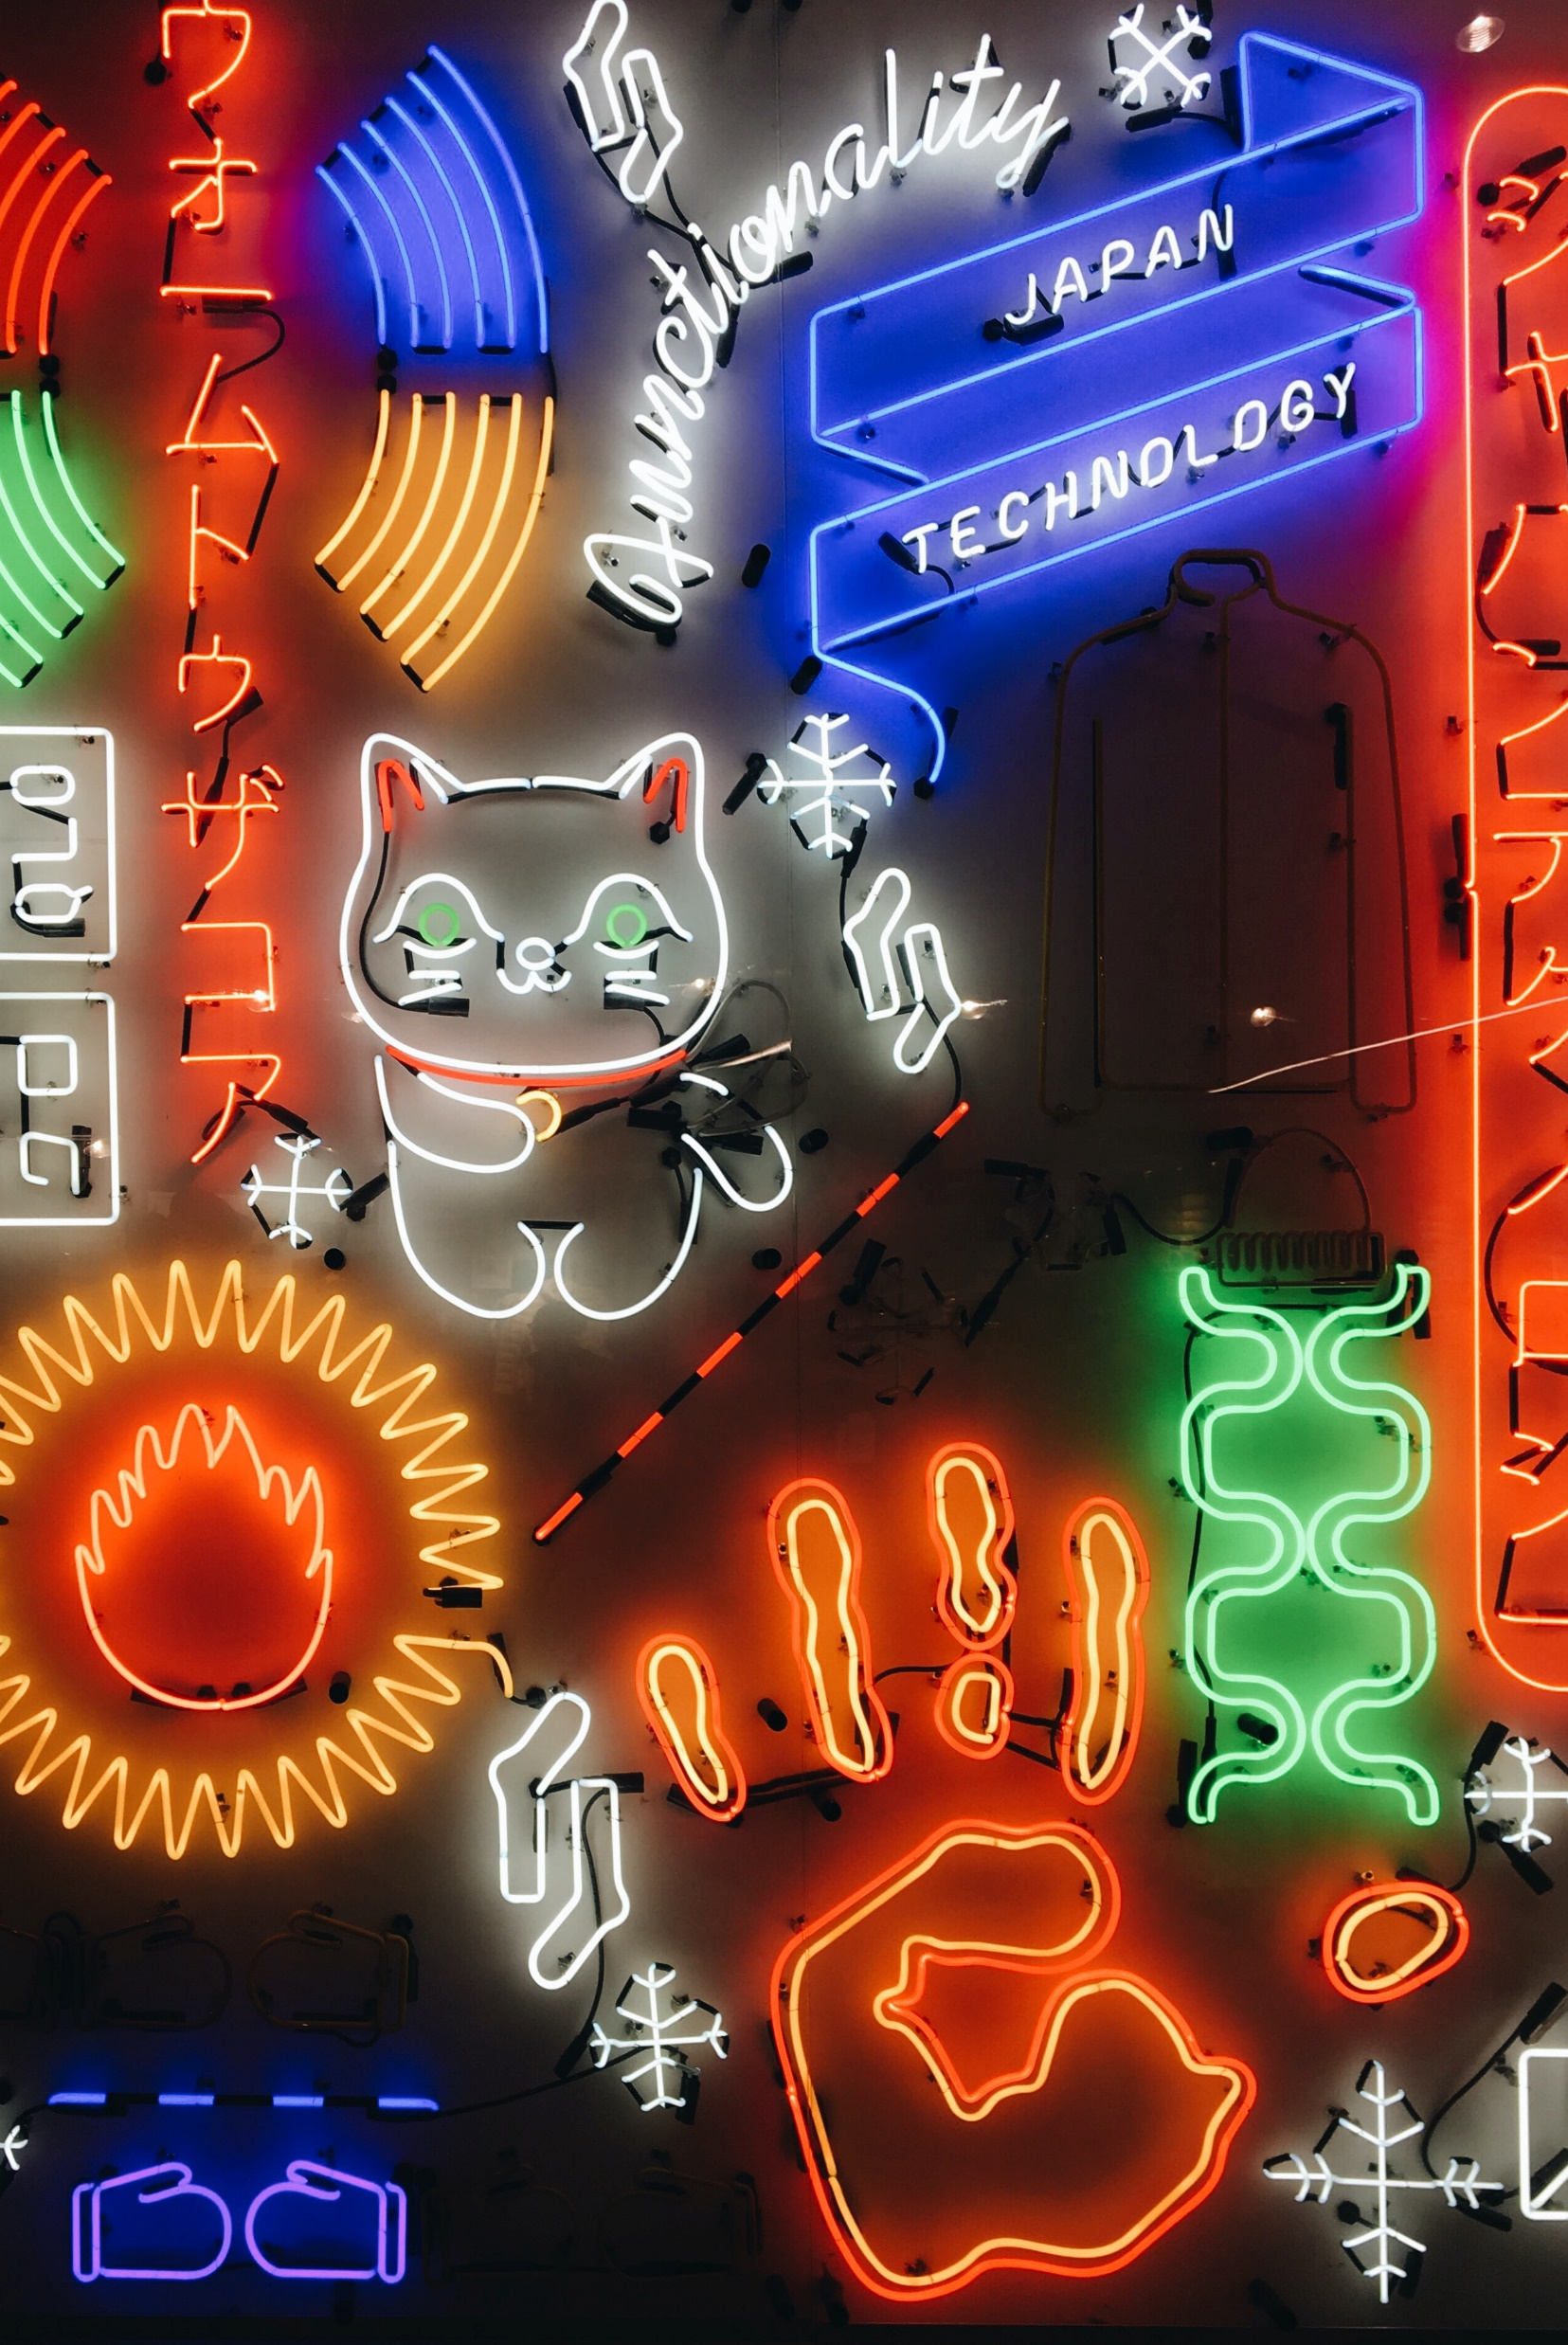
Uncertainty avoidance
Score 92 vs Singapore 8
One of the highest uncertainty avoidance score in the world
Unlikely to do things without precedence
Highly ritualized
In corporate, risk factors must be fully examined before coming to a decision
Requires detailed facts
Doesn’t like dealing with ambiguity
(Country Comparison - Hofstede Insights, 2021)

Slide 10
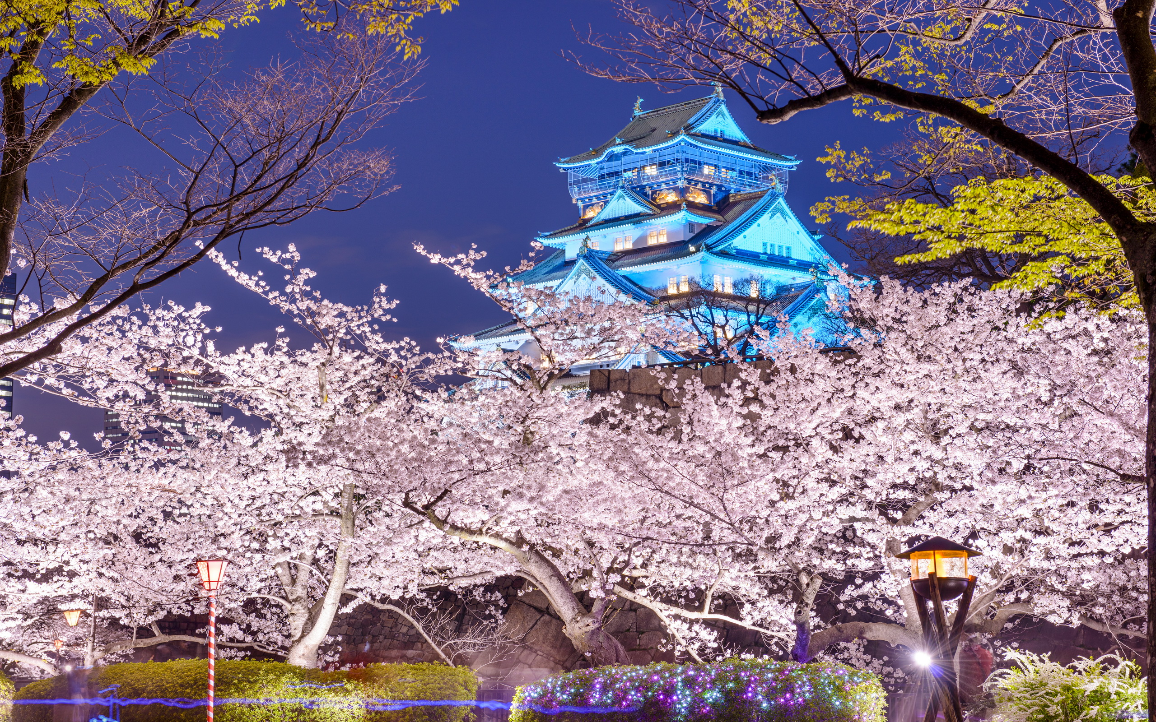
Short term vs long term
Score 88 vs Singapore 72
Work for the long term
Higher rate of investment into R&D
Steady market growth instead of sudden explosion
More for durability and the ability to serve generations
Less focus on quarterly or monthly growth
(Country Comparison - Hofstede Insights, 2021)

Slide 11
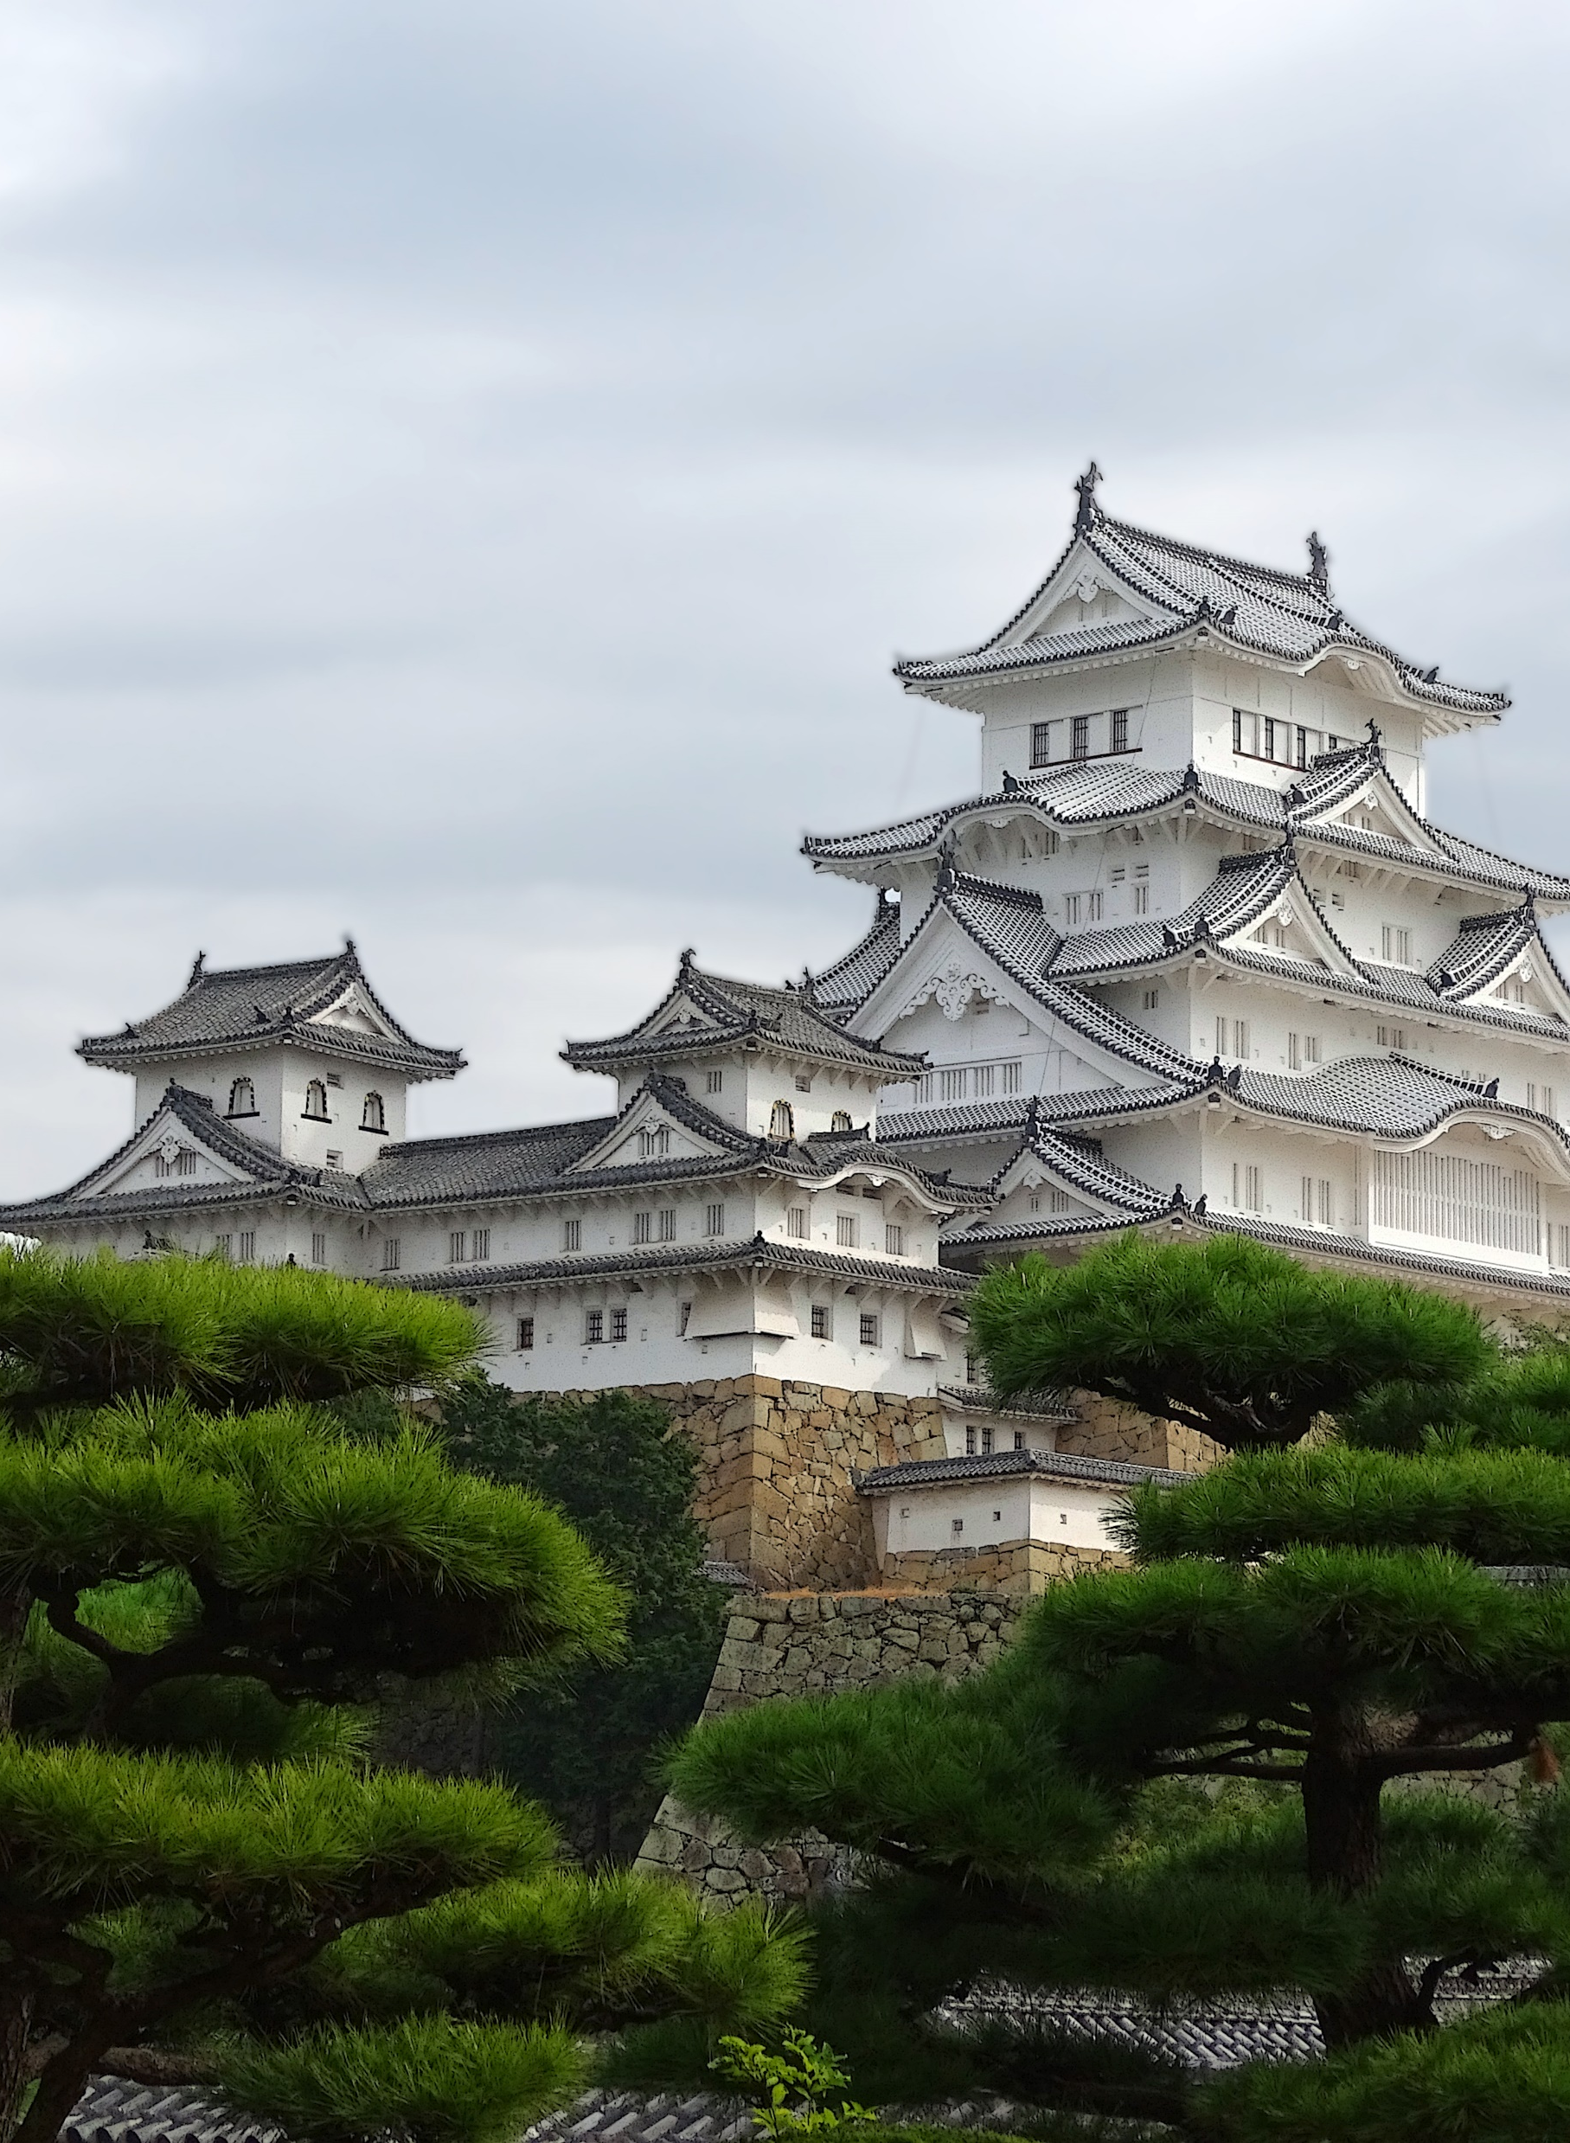
Indulgence vs restraint
Score 42 vs Singapore 46
Not much emphasis on leisure
Controls desires
Restrained by social norms
Due to drive for excellence, people constantly think they need to work overtime to get desired results, hence less priority is put on ‘having fun’
(Country Comparison - Hofstede Insights, 2021)

Slide 12
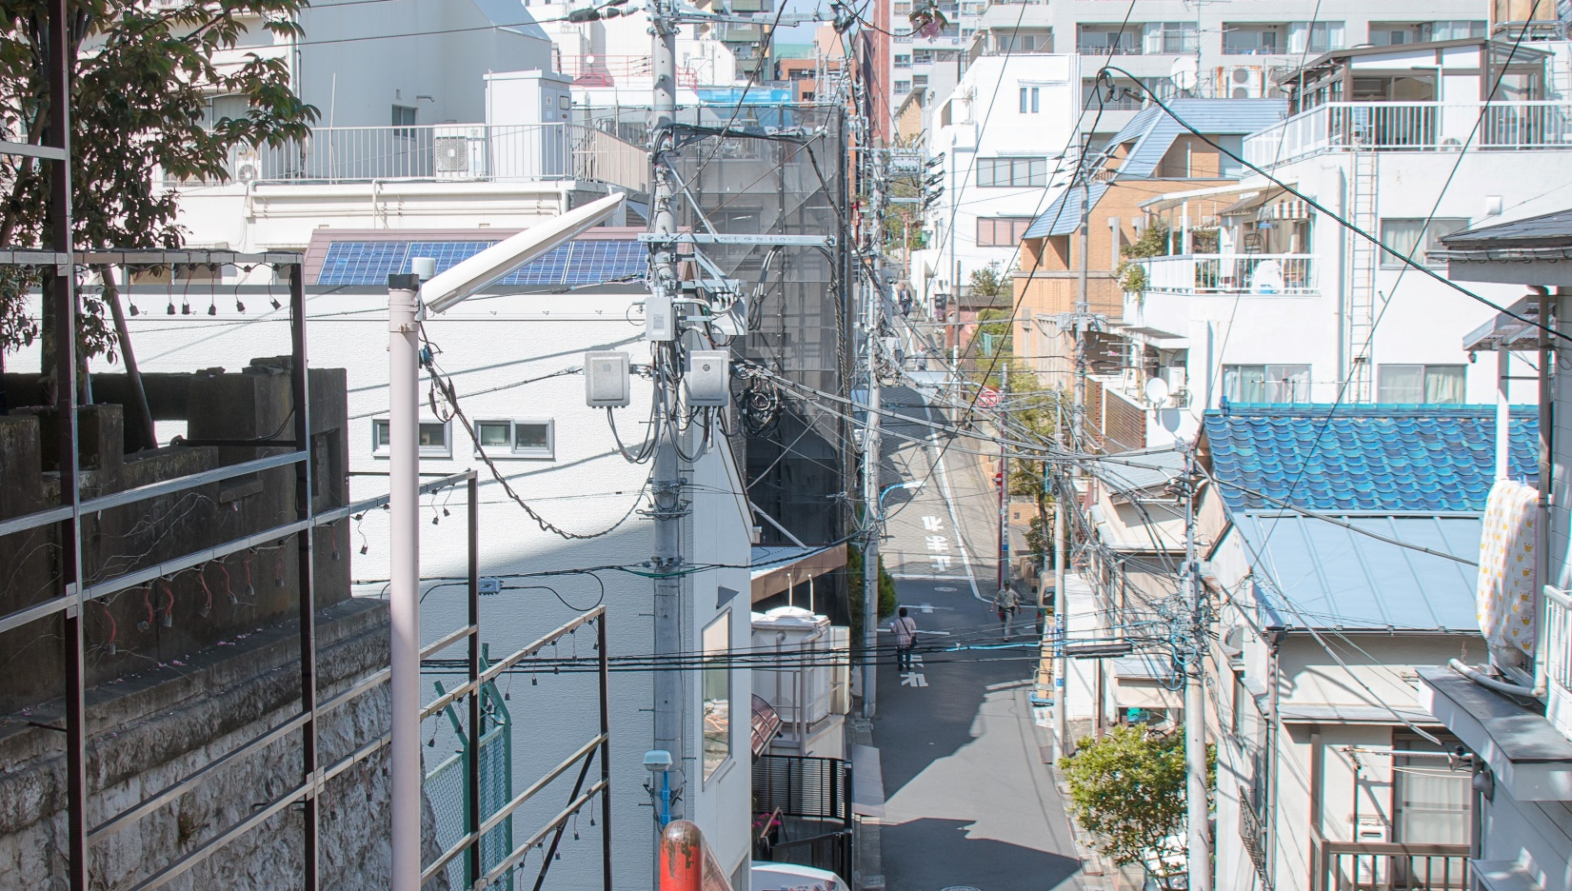

Negotiation styles
Avoidance
Competing
Collaborating
Accommodating
Compromising

Slide 13
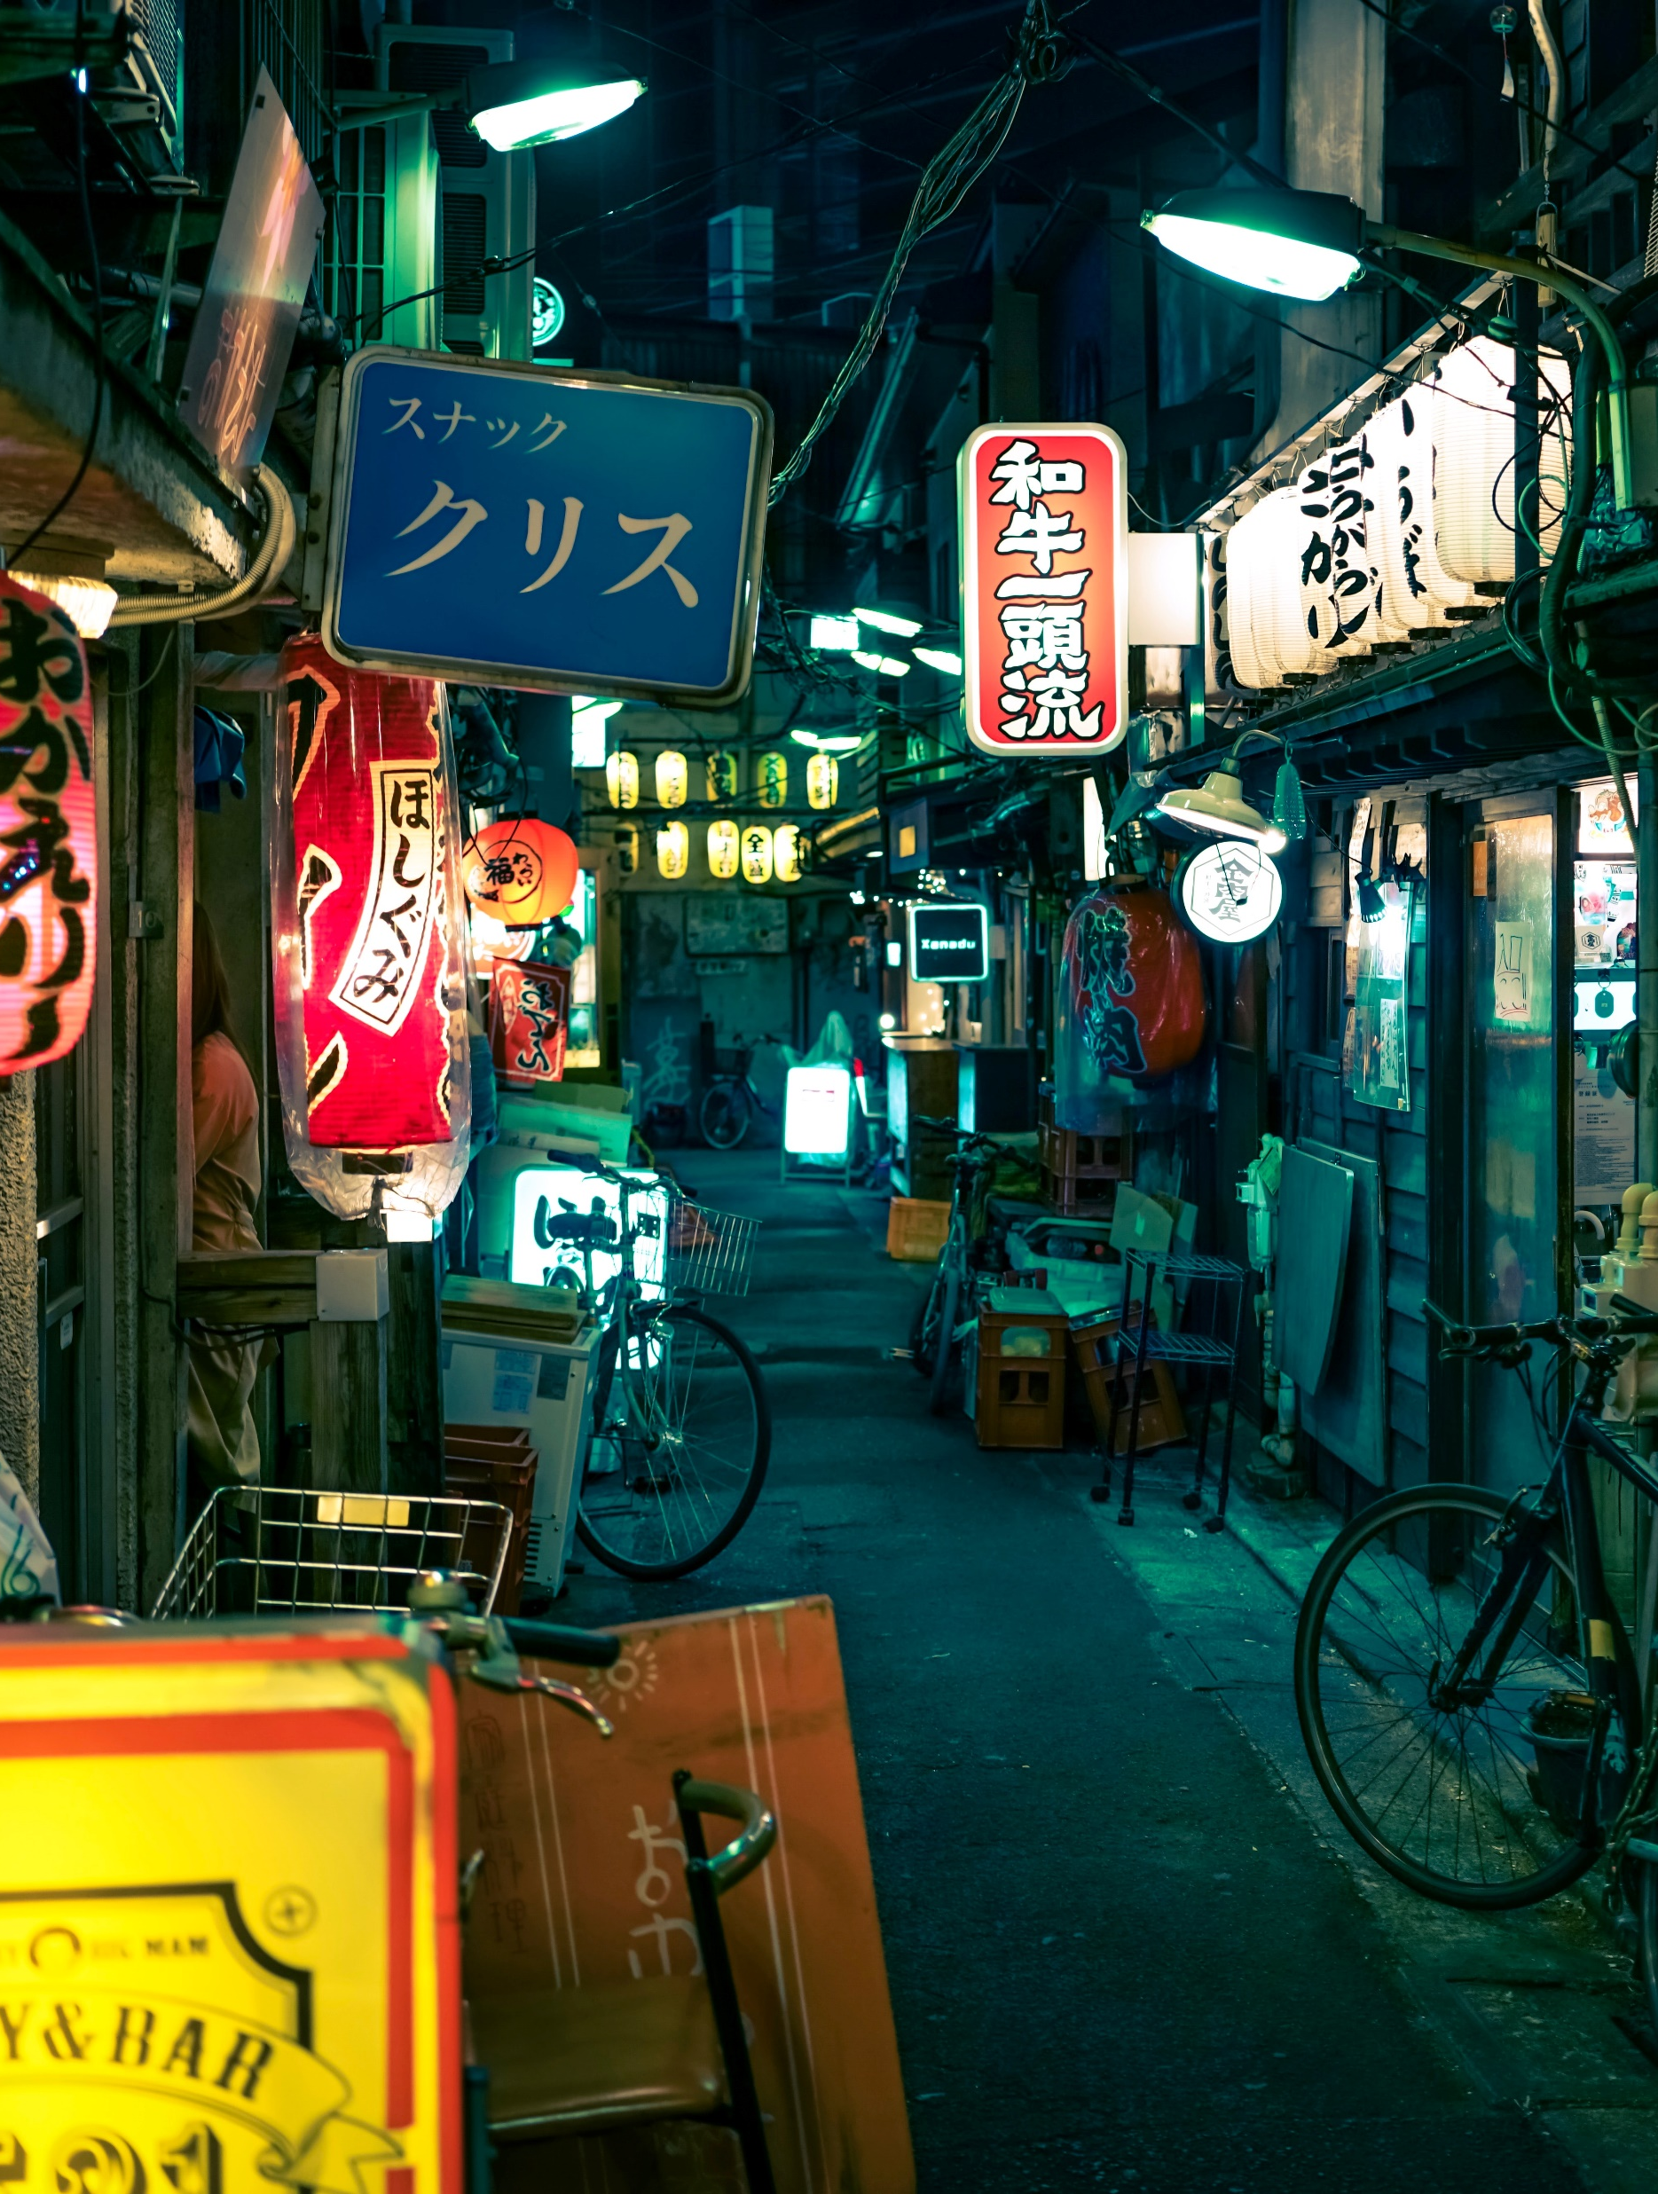
Avoidance
The Japanese are generally not keen on dealing with ambiguity
If the negotiation subject has grey areas or no precedence, the Japanese might take this approach.

Slide 14

Competing
The Japanese are least likely to use this approach
They do not want immediate results, hence if you’re able to present a guaranteed positive impact, they will be willing to listen
Also, they display collective traits like not letting other’s lose face, and not use assertive behavior to get what they want

Slide 15
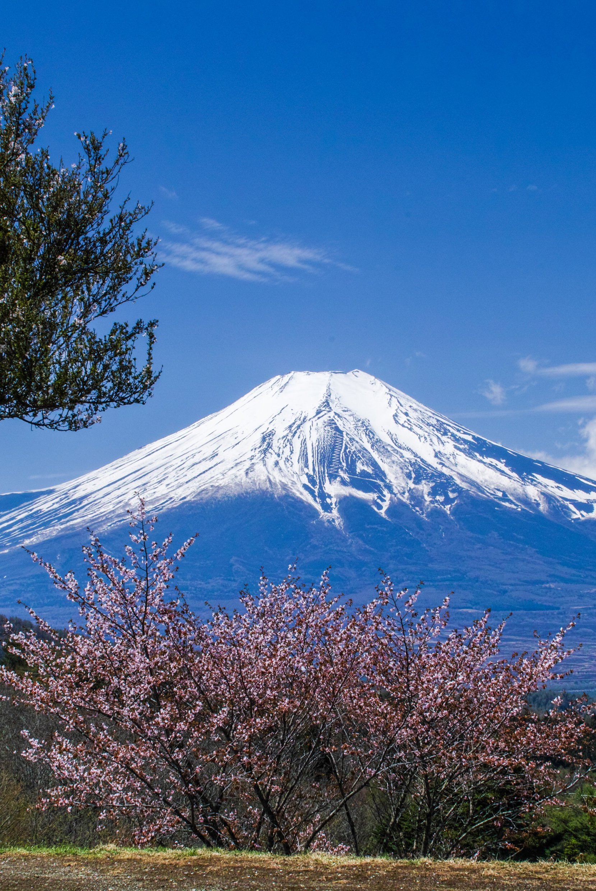
compromising
The Japanese are non-assertive, which means they are open to this approach.
However, their compromise can not have to be a compromise in quality or excellence as they take pride in it.
Long term oriented
If compromising can give a long-term return, they will likely compromise

Slide 16
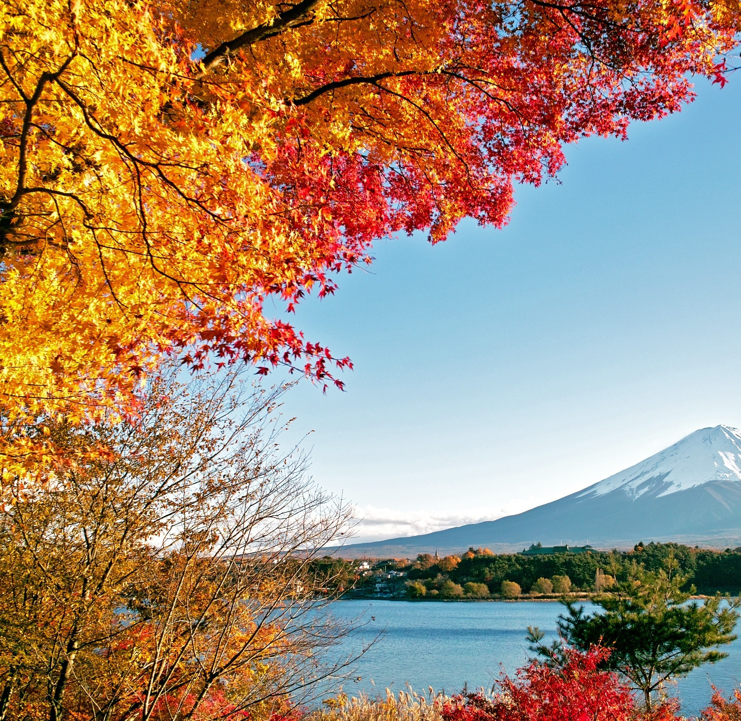
AccoMmodating
Japanese are masculine by nature, hence during a negotiation with a Japanese, it is good to recognize the client(Japanese) as the alpha and accommodate to him instead
Although Japanese are generally non-assertive, they do have pride and ego as they are one of the wealthiest countries in the world by GDP

Slide 17

Collaborating
Very like approach for the Japanese
If the negotiation approach is clear and has a long-term profit, the Japanese are likely to agree

Slide 18

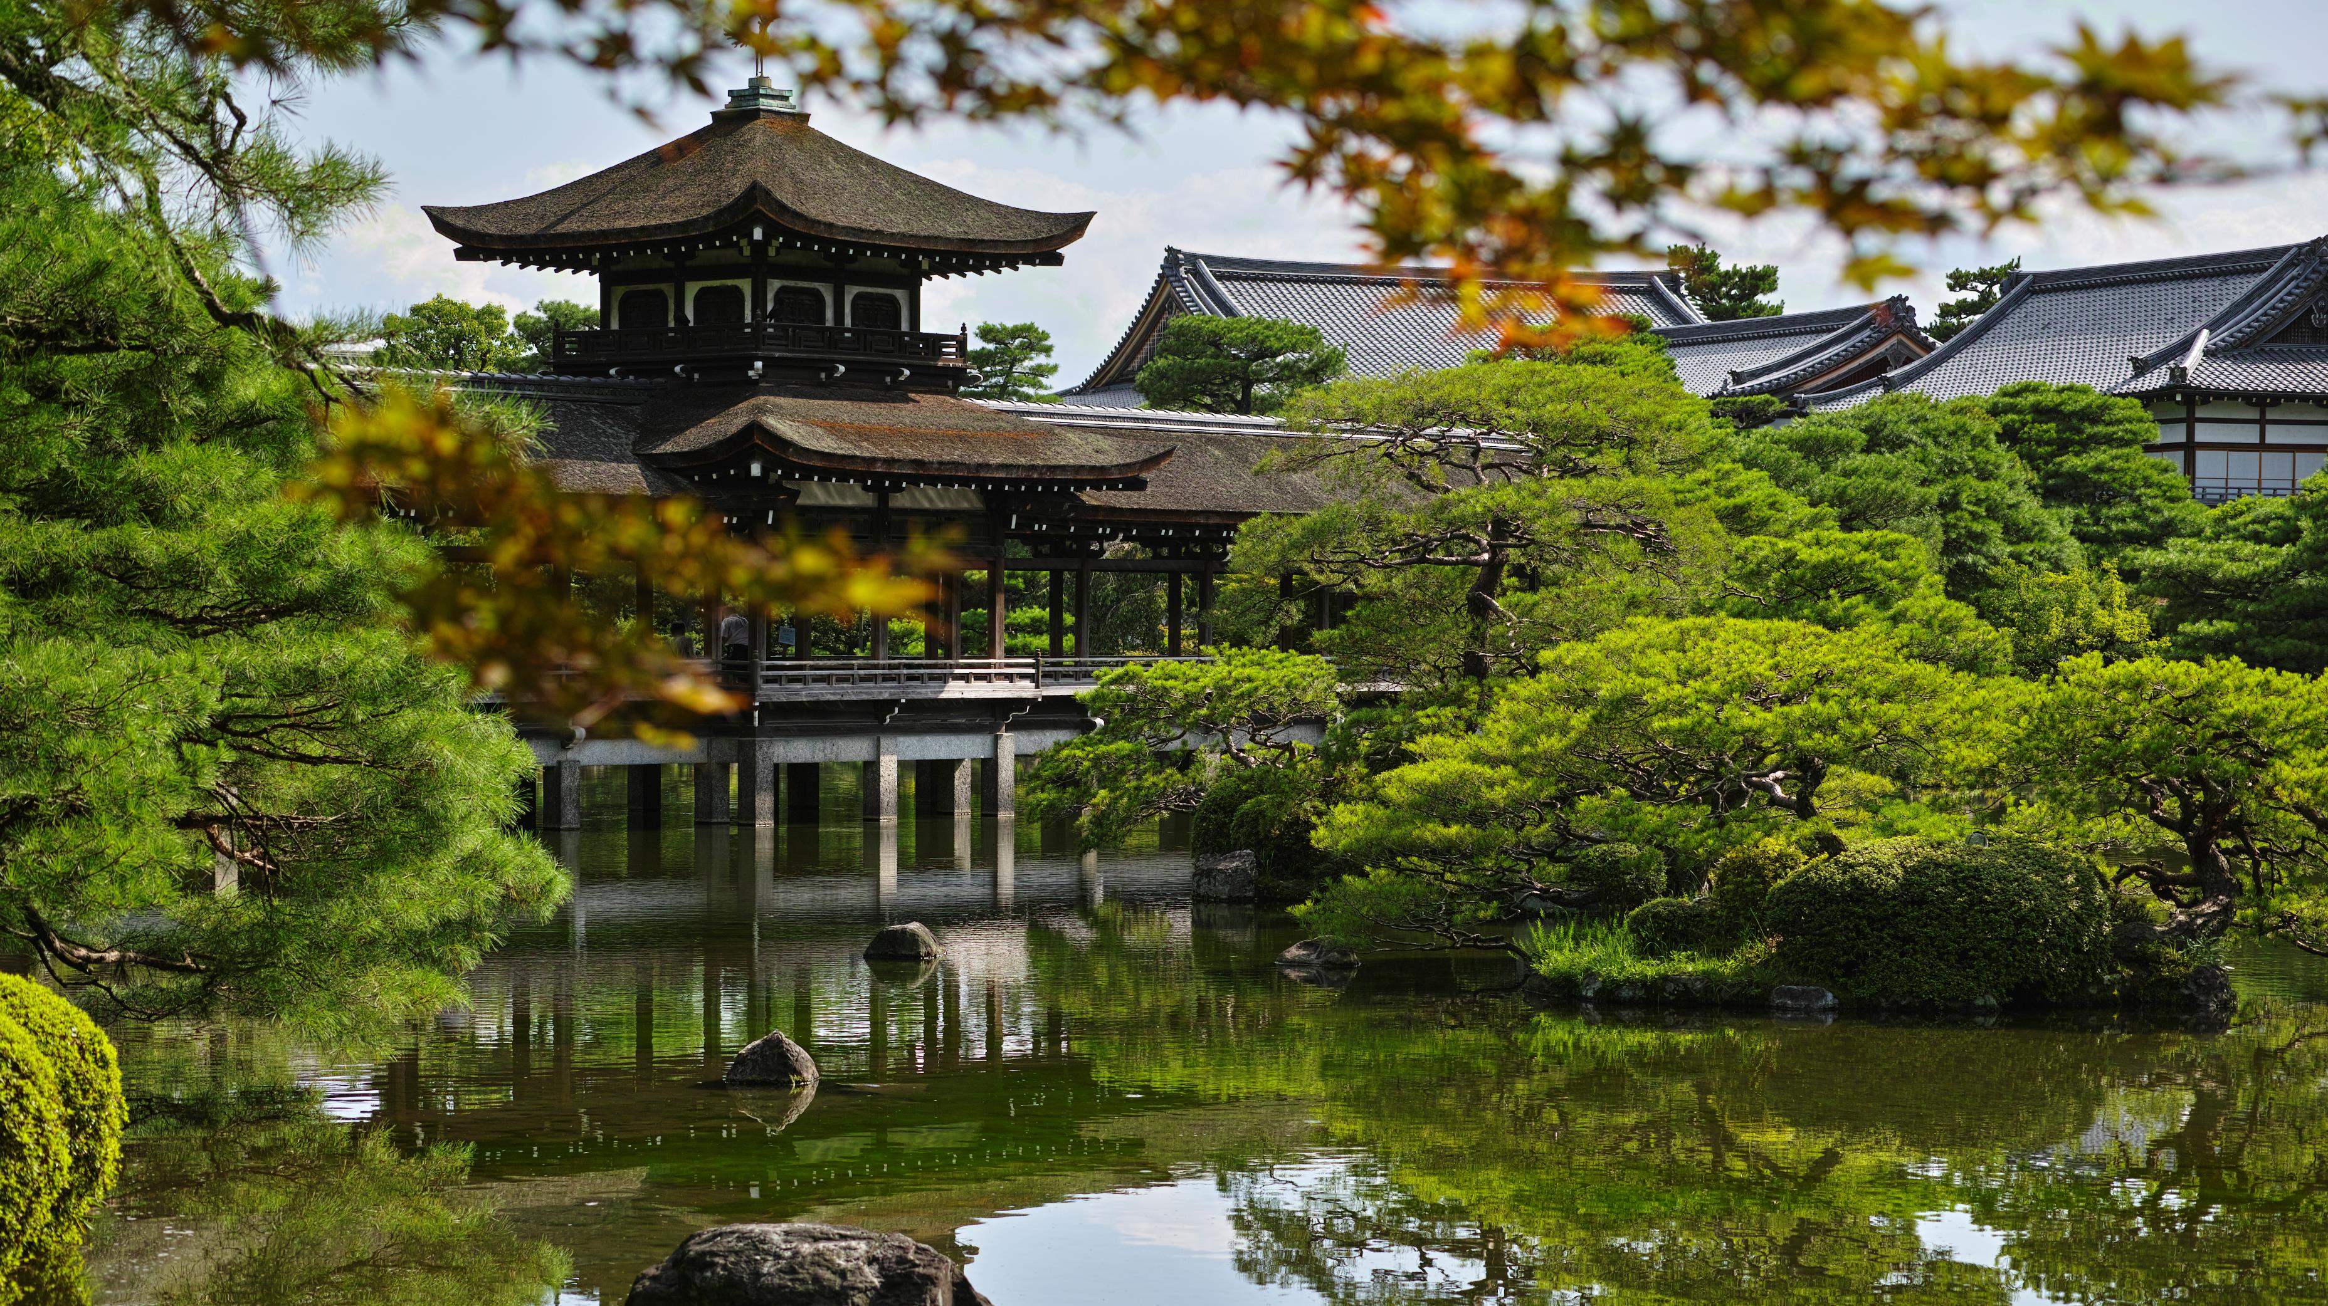
Q&A

Slide 19
References
Worldometers.info. 2021. Japan Demographics 2020 (Population, Age, Sex, Trends) - Worldometer. [online] Available at: <https://www.worldometers.info/demographics/japan-demographics/> [Accessed 10 February 2021].
Knoema. 2021. Japan Male to female ratio, 1950-2020 - knoema.com. [online] Available at: <https://knoema.com/atlas/Japan/topics/Demographics/Population/Male-to-female-ratio#:~:text=Japan%20%2D%20Male%20to%20female%20ratio%20of%20the%20total%20population&text=In%202020%2C%20male%20to%20female,per%20100%20females%20in%202020.> [Accessed 10 February 2021].
Spacey, J., 2021. 50 Japanese Manners And Customs. [online] Japan Talk. Available at: <https://www.japan-talk.com/jt/new/japanese-manners-and-customs> [Accessed 10 February 2021].
Riley, J., 2021. Hofstede's Model of National Cultures | Business | tutor2u. [online] tutor2u. Available at: <https://www.tutor2u.net/business/reference/hofstedes-national-cultures> [Accessed 10 February 2021].
Hofstede Insights. 2021. Country Comparison - Hofstede Insights. [online] Available at: <https://www.hofstede-insights.com/country-comparison/japan/#:~:text=Power%20Distance%20is%20defined%20as,is%20a%20borderline%20hierarchical%20society.> [Accessed 10 February 2021].

